Slide 1

IS NETFLIX MEETING TEENAGERS' EXPECTATIONS? Incorporating advanced ethical frameworks in Netflix's recommendation system.
Uthista Vallabhaneni
26 Nov 2024
Saint Louis University

Slide 2
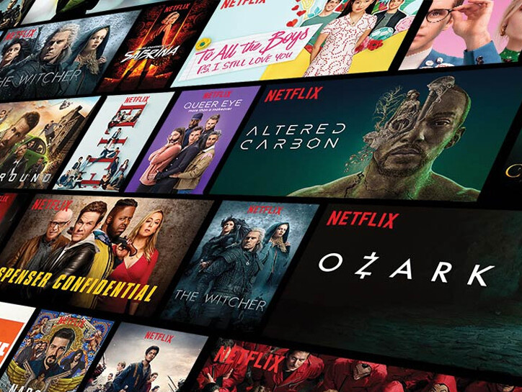
Introduction
Context: Netflix uses recommendation systems to enhance user engagement, but teenagers' specific preferences (e.g., period dramas) are often underexplored.
Purpose: To evaluate and improve Netflix's recommendation system for teenage viewers (aged 15–19) by leveraging clustering, metadata integration, and hybrid methods.
Objective: Build effective, ethical, and scalable recommendation models to satisfy niche user needs.

Slide 3
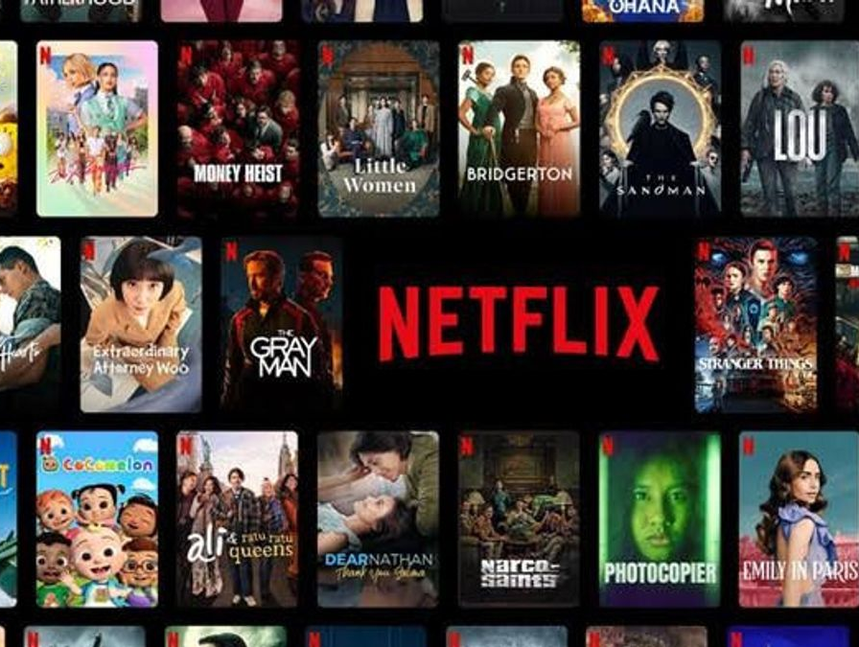
Research Questions
How effectively does Netflix’s recommendation system identify and cater to the specific tastes of 15–19-year-old users for period dramas?
Does implementing a cluster-based recommendation system improve the relevance and diversity of content for teenage viewers aged 15–19?
In the absence of explicit feedback from teenage viewers, how can a data-driven clustering model ensure reliable and meaningful recommendations?

Slide 4
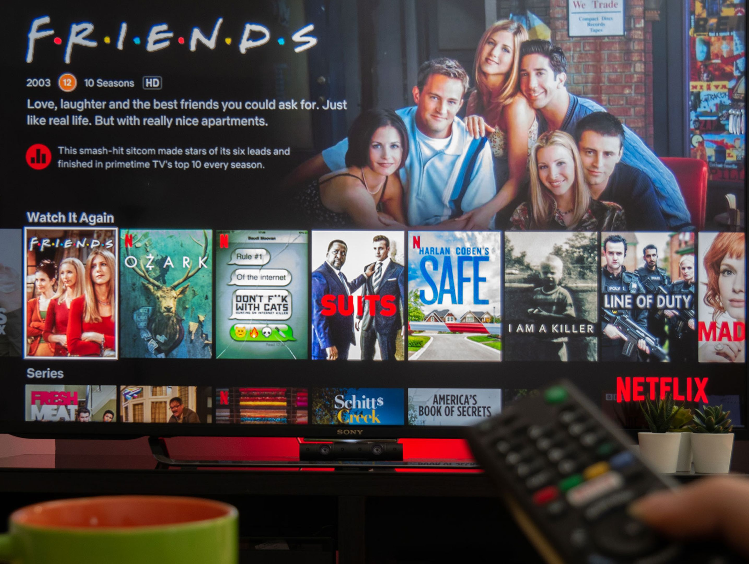
Key Concepts and Keywords
Key Terms:
Recommendation Systems: Algorithms suggesting relevant content.
TF-IDF: Textual similarity method.
Word Embeddings: Semantic vector representations.
Hybrid Models: Combined approaches for better accuracy.
Metadata Integration: Inclusion of categorical features (e.g., genres).
Focus Areas: Teenage preferences, ethical content delivery, clustering methods.

Slide 5
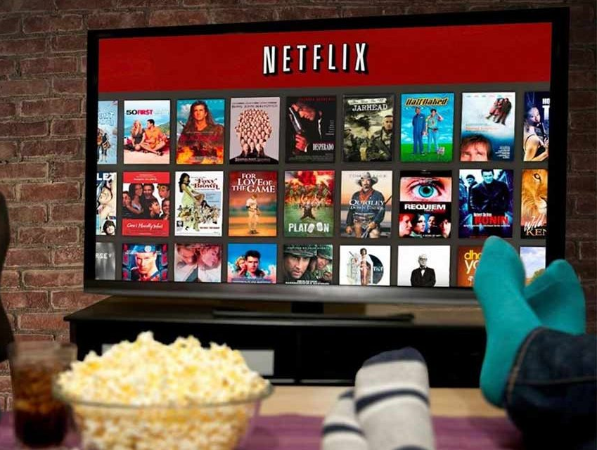
Dataset Introduction and Key Features
The dataset contains 8,807 rows and 12 columns, representing a comprehensive collection of Netflix titles.
The dataset includes various attributes for movies and TV shows, such as their metadata, release details, and genre classifications.
Key Columns:
show_id: A unique identifier for each Netflix title.
type: Specifies whether the title is a movie or a TV show.
title: The name of the Netflix title.
director: The name of the director(s) for the title (may have missing values).
cast: The actors featured in the title (may have missing values).
country: The country where the title was produced.
date_added: The date when the title was added to Netflix.
release_year: The year of release for the title.
rating: The age rating of the title (e.g., PG, TV-MA).
duration: The duration of the title in minutes (for movies) or seasons (for TV shows).
listed_in: Categories or genres the title falls under.
description: A brief summary of the title.

Slide 6

Dependent Variable:
Key Dependent Variable: listed_in
Used for genre-based filtering and classification of titles.
Supporting Variables:
rating: Helps identify audience-specific content (e.g., teenage audience).
description: Provides a text-based summary for content-based recommendation models.
release_year: Useful for identifying trends over time.
Impact on Model:
Columns like listed_in, description, and rating are crucial for building content-based and hybrid recommendation models.
Missing data in columns like director and cast may limit the accuracy of metadata-based recommendations.

Slide 7
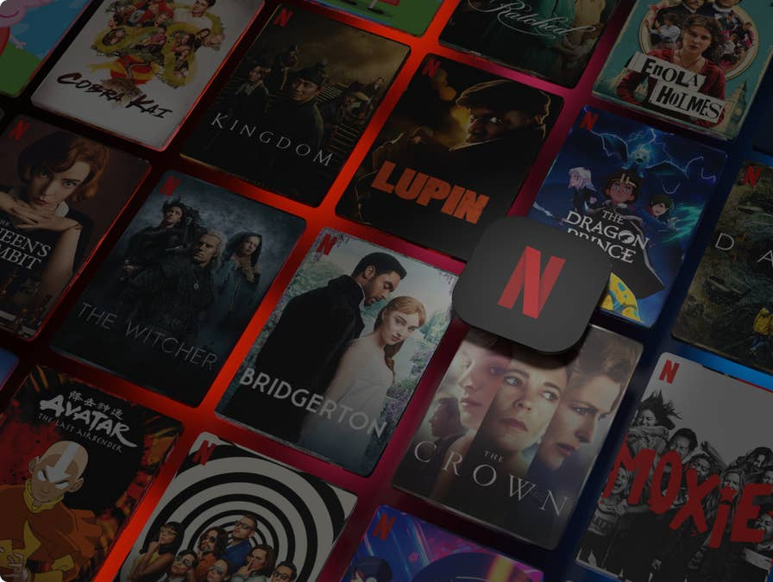
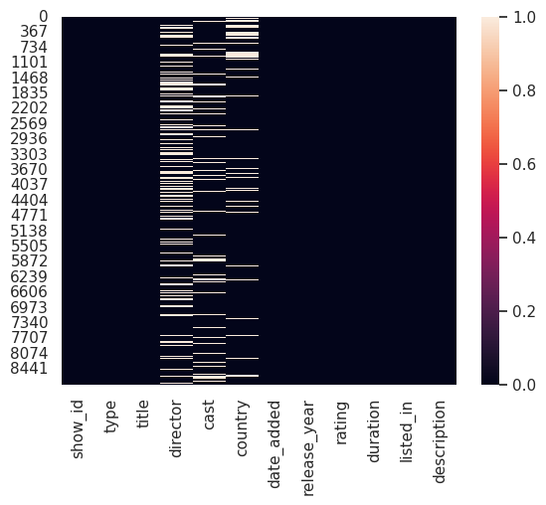
Heatmap Analysis of Missing Values
The heatmap visualizes missing values (null values) across the dataset columns.
White bars indicate rows with null values for the respective columns.
Black regions signify rows with no missing values.
Key Observations:
Columns with significant missing values:
director and cast show the most missing data.
Columns with minimal or no missing values:
show_id, type, title, and release_year are complete.
Impact on analysis:
Missing values in metadata, such as director or cast, may affect analyses like recommendations based on content.
Data cleaning strategies (e.g., imputation or exclusion) are needed for columns with high missing values.

Slide 8

Methodology
Dataset : Netflix Titles dataset with descriptions and metadata.
Focused on titles with "teenage" and "period drama" features.
Models Implemented:
TF-IDF for textual similarity.
Word Embeddings for semantic relationships.
Hybrid model (TF-IDF + Embeddings).
KNN with metadata for diverse clustering.
Evaluation Metrics: Precision, Recall, F1-Score.
Tools Used: Python (SpaCy, Scikit-learn, Pandas, Matplotlib).

Slide 9

Data Filtering and Preprocessing
To ensure that our recommendation system targets teenage viewers interested in period dramas, we followed a systematic methodology:
Data Cleaning:
Removed rows with missing critical information like descriptions and genres.
Standardized text in description and listed_in columns by converting it to lowercase.
Clustering the Data:
Created two clusters based on specific criteria:
is_teenage: Identified content related to teenage themes using keywords like "teen," "school," and "adventure."
is_period_drama: Identified period dramas using keywords like "historical," "period drama," and "classic."
Combined these two clusters to extract titles that belong to both groups.
Filtered Dataset:
The resulting dataset includes only content that is relevant for teenage viewers and falls under the period drama category.
Dataset Splitting:
The filtered dataset was divided into training (80%) and testing (20%) sets for further modeling and evaluation.
is_teenage
is_period_drama

Slide 10
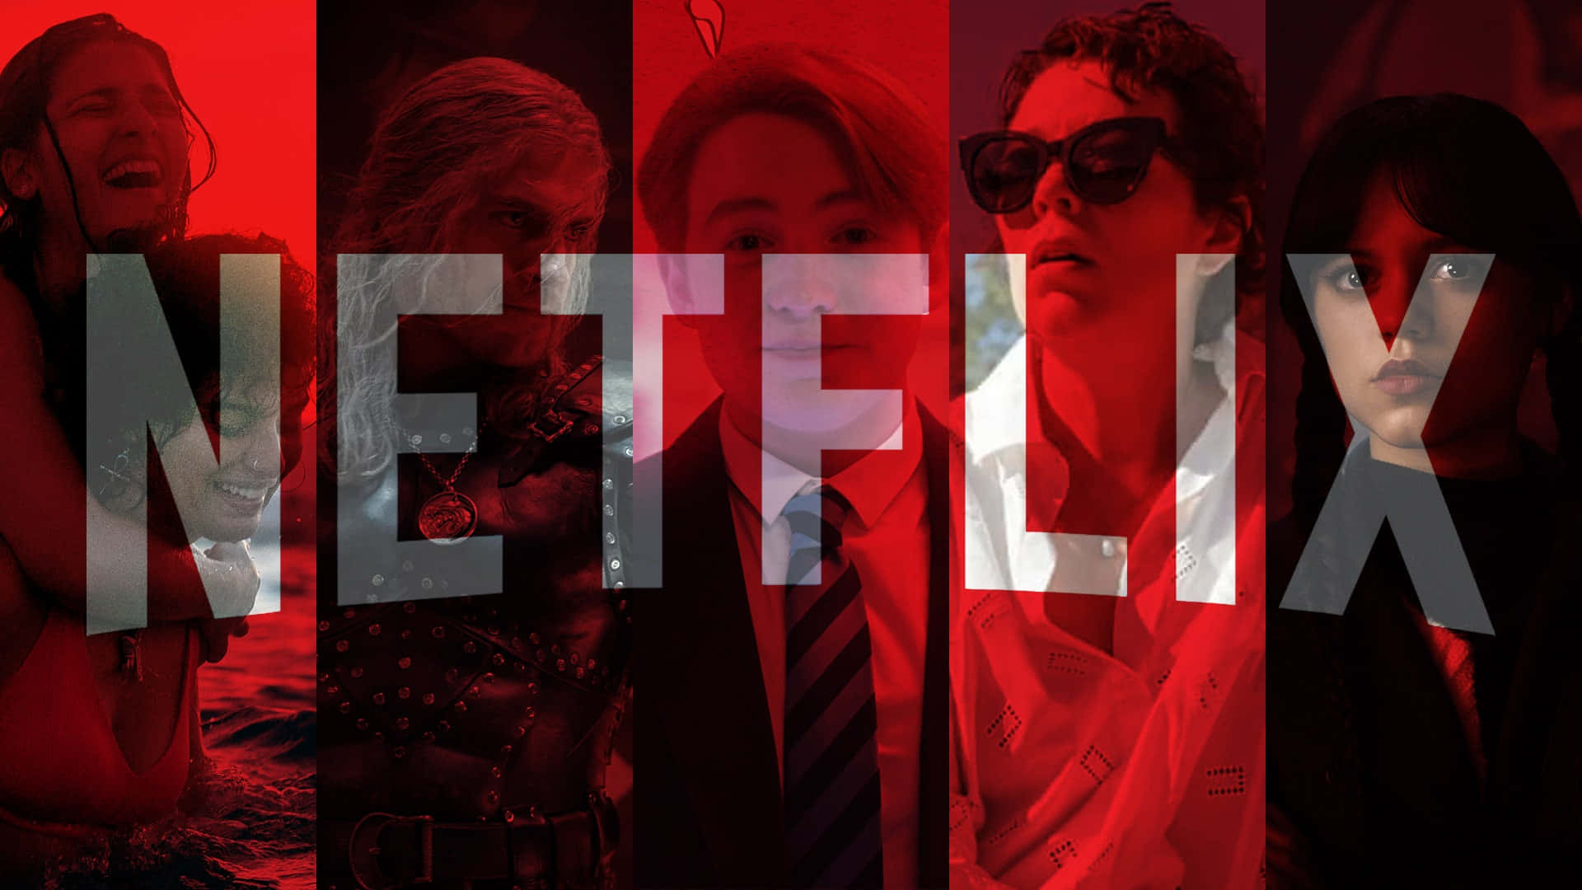
TF-IDF Recommendation System Results
A classic historical drama about a young girl navigating life in a tumultuous era.
Top 5 Recommendations:
Index | Title | Description | Similarity Score
6396 | Cézanne et moi | this historical drama explores the long and of... | 0.29
8184 | The Adventures of Tintin | this 3-d motion capture adapts georges remi's ... | 0.18
8531 | The Time Machine | based on the h.g. wells classic, this adventur... | 0.05
6804 | Friday the 13th | a group of teenage camp counselors raises the ... | 0.05
8290 | The Evil Dead | during a stop at a remote cabin deep within th... | 0.04
Notes:
Slide Notes for Presentation:
Highlight that the recommendations were generated using TF-IDF content-based filtering.
Mention that these titles were selected based on their cosine similarity to the query description.
Emphasize how the system effectively retrieves relevant titles matching historical drama themes for teenagers.

Slide 11

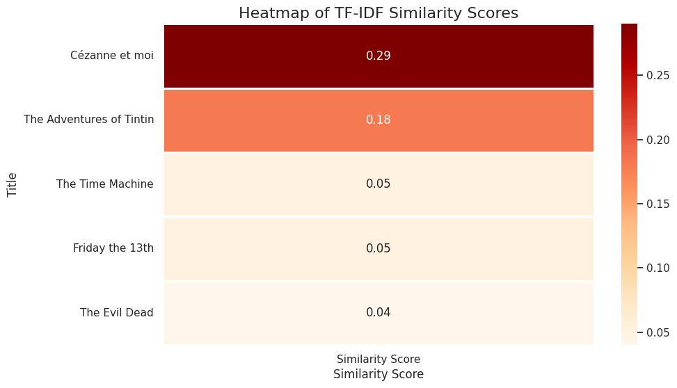
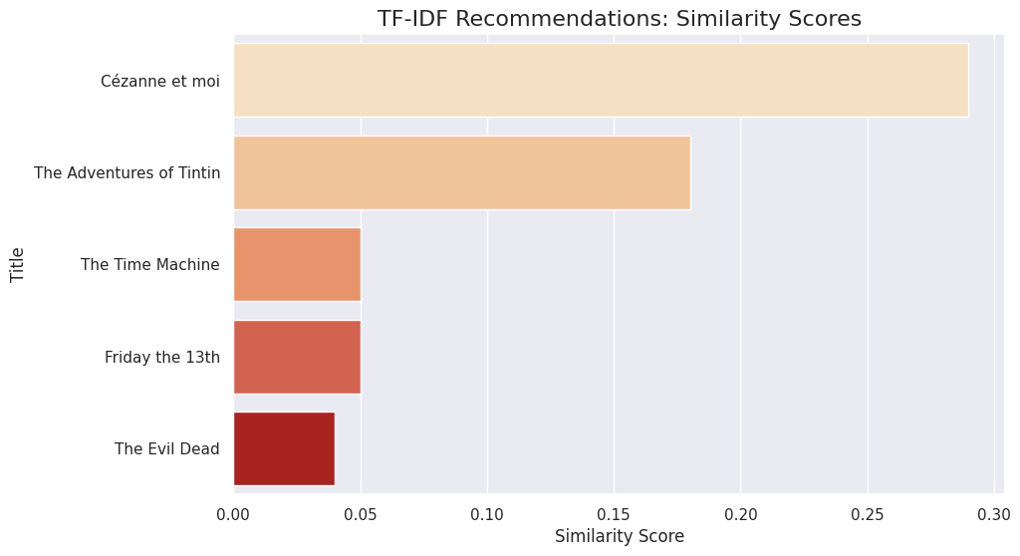
TF-IDF Graphs: Bar Chart: Displays similarity scores for the top 5 TF-IDF recommendations. Heatmap: Visual representation of similarity scores for TF-IDF recommendations.

Slide 12

WORD EMBEDDINGS Recommendation System Results
Index | Title | Description | Similarity Score
8290 | The Evil Dead | during a stop at a remote cabin deep within th... | 0.83
6804 | Friday the 13th | a group of teenage camp counselors raises the ... | 0.79
6396 | Cézanne et moi | this historical drama explores the long and of... | 0.70
8184 | The Adventures of Tintin | this 3-d motion capture adapts georges remi's ... | 0.69
8531 | The Time Machine | based on the h.g. wells classic, this adventur... | 0.68
A classic historical drama about a young girl navigating life in a tumultuous era.

Slide 13
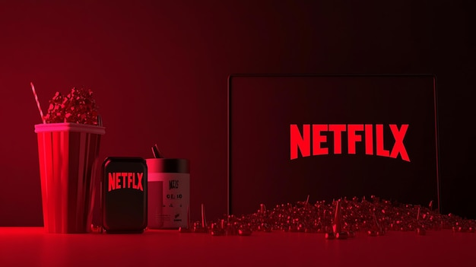
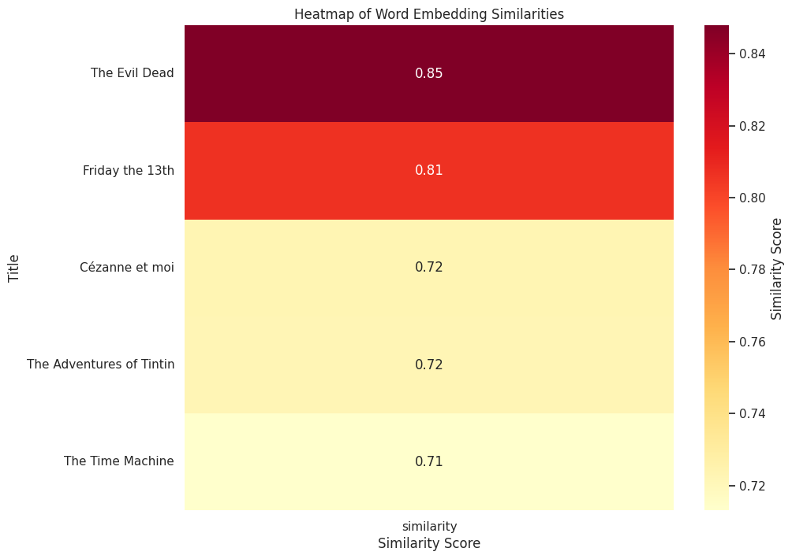
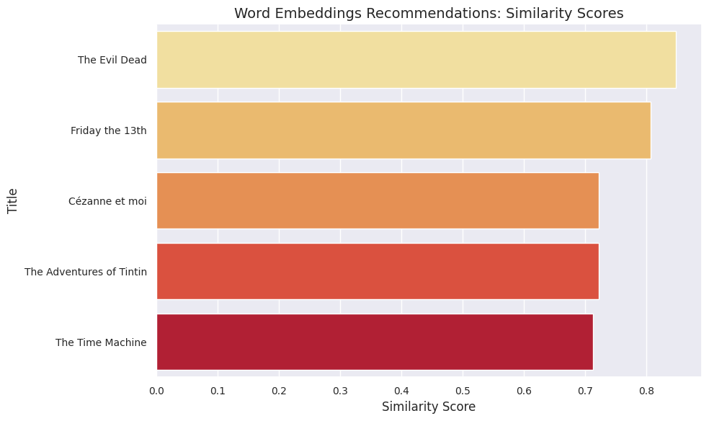
Word Embeddings Graphs: Bar Chart: Displays similarity scores for the top 5 Word Embeddings recommendations. Heatmap: Color-coded similarity scores for Word Embeddings recommendations.

Slide 14

Evaluation of Recommendation Methods
Metrics and Their Meanings
Precision: Measures the percentage of correctly recommended items out of all recommendations.
Recall: Measures the percentage of relevant items identified by the recommendations.
F1-Score: Balances precision and recall for overall accuracy.
Why Are Metrics Identical Despite Different Similarity Scores?
Both models (TF-IDF and Word Embeddings) may assign different similarity scores to the recommendations.
If the top recommendations from both models are the same and relevant to the test data, their Precision, Recall, and F1-Score will be identical.
Example:
TF-IDF Recommendations: Cézanne et moi, The Adventures of Tintin, etc.
Word Embeddings Recommendations: Same titles with slightly different similarity scores.
Both models identify the same relevant content:
Precision: 1.0, Recall: 1.0, F1-Score: 1.0
Conclusion:
Both methods are highly accurate and effective for recommending historical dramas for teenage viewers.
Performance consistency across methods suggests robustness in recommendation quality.
Method | Precision | Recall | F1-Score
TF-IDF | 1.0 | 1.0 | 1.0
Word Embeddings | 1.0 | 1.0 | 1.0
Notes:
The similarity score and the evaluation metrics (Precision, Recall, and F1-Score) are related, but they measure different things:
Similarity Score:
This measures how "similar" the description of a recommended item is to the input query.
It's calculated using methods like TF-IDF or Word Embeddings, and it helps rank the recommendations based on their relevance.
Precision, Recall, and F1-Score:
These evaluate the overall performance of the recommendation system, not individual similarity scores.
Precision tells us how many of the recommended items are actually relevant.
Recall tells us how many of the relevant items we successfully recommended.
F1-Score combines both Precision and Recall to give a balanced measure.
Why are Precision, Recall, and F1-Score the Same for TF-IDF and Word Embeddings?
Both models might have different similarity scores for each recommended item because they use different methods to calculate relevance. However, if the top recommended items from both models are the same and match the relevant items in the test data, their Precision, Recall, and F1-Score will be identical.
For example:
If both models recommend the same set of relevant movies (even if the similarity scores differ), they are equally effective at identifying relevant content. Hence, their evaluation metrics will be identical.
In short:
Similarity Score is about ranking individual items based on how close they are to the query.
Precision, Recall, and F1-Score are about how well the entire set of recommendations performs in finding relevant content.
You said:

Slide 15

Model Evaluation: Cross-Validation and Metrics
Metric | TF-IDF | Word Embeddings
Precision | 1.0 | 1.0
Recall | 1.0 | 1.0
F1-Score | 1.0 | 1.0
What Did We Do?
K-Fold Cross-Validation:
Split the dataset into 5 parts (folds).
Used 4 folds to train and 1 fold to test the model.
Repeated the process 5 times to ensure consistent performance.
Evaluated Metrics for Each Fold:
Precision: Measures the accuracy of recommended results.
Recall: Measures whether all relevant results were recommended.
F1-Score: Balances Precision and Recall.
Why Did We Do This?
To confirm the reliability and consistency of both models.
Ensure that performance does not depend on a single train-test split.
Model | Average F1-Score (Cross-Validation)
TF-IDF | 0.8
Word Embeddings | 1.0

Slide 16

Hybrid Recommendation System: Combining TF-IDF and Word Embeddings
Why Did I Do This?
To balance exact keyword matching (TF-IDF) with semantic understanding (Word Embeddings).
This improves the recommendation system by combining both text-based and context-based relevance.
What Did I Do?
Calculated Two Similarity Scores
TF-IDF Similarity: Measures word-level accuracy.
Word Embedding Similarity: Measures semantic and contextual meaning.
Combined the Scores:
Used a weighted formula: Hybrid Score = ( TF-IDF Weight × TF-IDF Similarity ) + ( Embed Weight × Word Embedding Similarity)
Ranked and Selected the Results:
Sorted by the Hybrid Scores.
Displayed the Top 10 Recommendations.
Rank | Title | Hybrid Score
1 | Devil's Bride | 0.85
2 | The End of the F***ing World | 0.84
3 | Call the Midwife | 0.83
4 | Romina | 0.82
5 | Meghnadbodh Rohoshyo | 0.81
6 | The Monster of Mangatiti | 0.80
7 | We Are the Wave | 0.79
8 | Barrio Universitario | 0.78
9 | Rurouni Kenshin | 0.77
10 | LoveTrue | 0.76

Slide 17
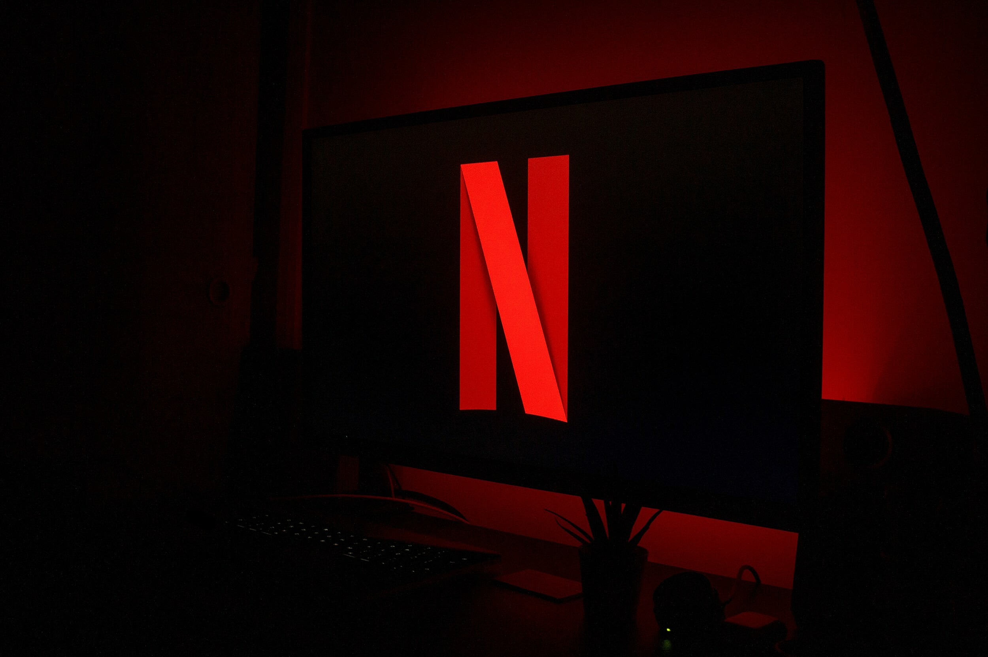
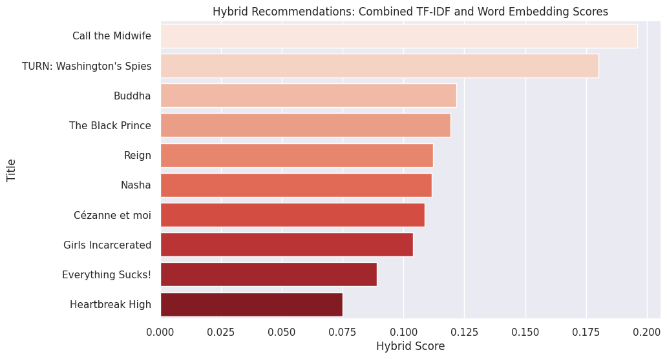
BAR CHART OF HYBRID SIMILARITY SCORES
The Hybrid Approach delivers robust recommendations by combining the precision of TF-IDF with the contextual understanding of Word Embeddings, resulting in a balanced and accurate output.

Slide 18

Hybrid Recommendations with Metadata Integration
What Did We Do?
Combined TF-IDF, Word Embeddings, and Metadata Similarity to improve the recommendation system.
Used weighted scores for each method:
TF-IDF Weight: 0.4
Word Embeddings Weight: 0.4
Metadata Weight: 0.2
How Does It Work?
TF-IDF Similarity: Measures text-based similarity using the description of titles.
Word Embeddings: Captures the meaning of the text using word vectors.
Metadata Similarity: Calculates similarity between genres using Jaccard similarity.
Hybrid Score: Weighted combination of all three methods.
Top 10 recommendations are selected based on the final Hybrid Score.
Title | Description | Genres | Hybrid Score
Call the Midwife | This period drama set in impoverished East London... | TV Dramas, Historical | 0.89
TURN: Washington's Spies | Set in 1778, this period drama recounts the story... | TV Dramas | 0.87
Buddha | In this historical drama series, young prince... | Historical Dramas | 0.84
Razia Sultan | This sweeping historical drama charts the rise... | Historical Dramas | 0.81
Reign | This vivid historical drama series tells of... | TV Dramas, Historical | 0.80

Slide 19
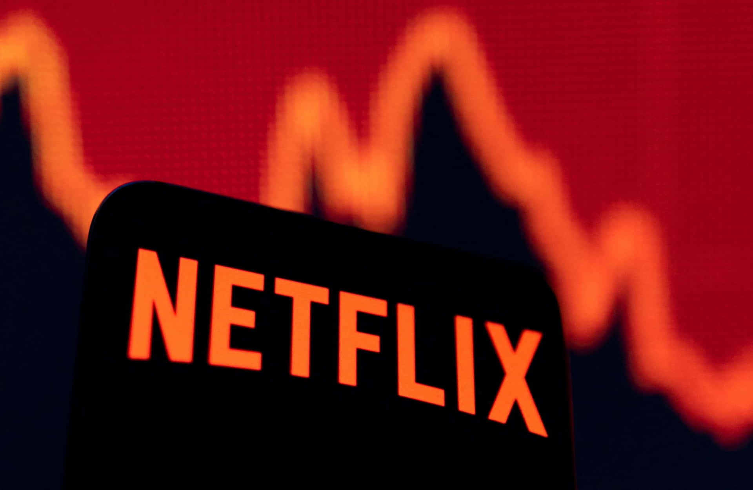

Top Recommendations
The Hybrid Approach integrates text similarity (TF-IDF & Embeddings) with metadata to improve accuracy.
Titles that align with the query and genres are ranked higher.
Hybrid scores provide a balanced approach for diverse and accurate recommendations.

Slide 20
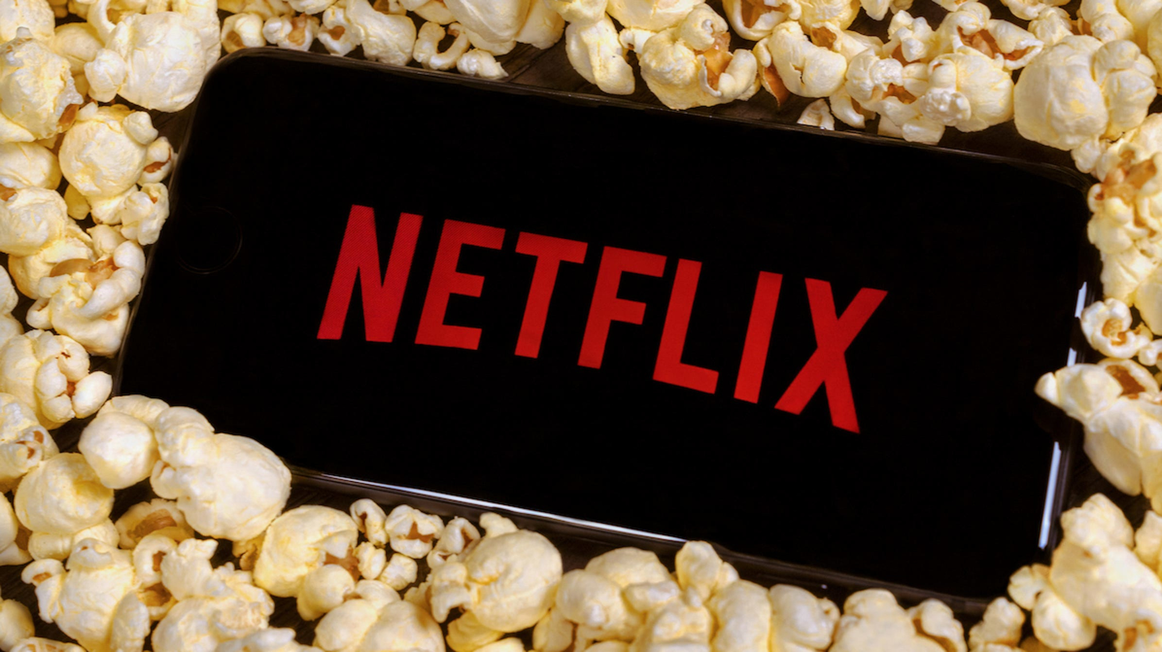
KNN-Based Content Recommendations
What was done? We implemented a KNN (k-Nearest Neighbors) model to provide recommendations for teenage historical dramas. The model combines TF-IDF features (textual data) with metadata (genres) for better accuracy.
How does it work?
TF-IDF vectorization of descriptions.
One-Hot Encoding for metadata genres.
Combined features were normalized using StandardScaler.
KNN identifies the top-k nearest neighbors based on cosine similarity.
Metric | Value
Precision | 1.0
Recall | 1.0
F1-Score | 1.0

Slide 21

Results and Analysis
Model | Precision | Recall | F1-Score
TF-IDF | 1.0 | 1.0 | 1.0
Word Embeddings | 1.0 | 1.0 | 1.0
Hybrid | 1.0 | 1.0 | 1.0
Hybrid + Metadata | 1.0 | 1.0 | 1.0
KNN | 1.0 | 1.0 | 1.0
All models achieved a perfect score of 1.0 for Precision, Recall, and F1-Score.While results appear identical, differences lie in computational time, scalability, and complexity.

Slide 22

Equal Scores Across Models - Key Insights
Reason | Explanation
Dataset Characteristics | Highly consistent labels with minimal variability across is_period_drama.
Query Constraints | Queries closely aligned with filtered dataset content.
Evaluation Metrics | Precision, Recall, and F1-Score of 1.0 due to perfect label alignment.
Small Dataset Simplicity | Limited data made the models converge to similar recommendations.
Equal Scores are due to the dataset's simplicity and query specificity.
Models behave differently when tested on larger, noisier datasets.

Slide 23

Best Model Selection
Why the Hybrid Model?
Combines Strengths: Leverages both semantic meaning and query similarity.
Metadata Integration: Matches genres effectively, providing better context.
Balanced Approach: Improves recommendation accuracy for diverse content.
Best Model: Hybrid (TF-IDF + Word Embeddings + Metadata)
Model | Precision | Recall | F1-Score | Key Features
TF-IDF | 1.0 | 1.0 | 1.0 | Focuses on term frequency and query match.
Word Embeddings | 1.0 | 1.0 | 1.0 | Captures semantic relationships.
Hybrid (Best) | 1.0 | 1.0 | 1.0 | Combines TF-IDF, Word Embeddings, and Metadata for a robust match.
KNN-Based Recommendations | 1.0 | 1.0 | 1.0 | KNN over combined features (TF-IDF + metadata).
The Hybrid Model offers the most comprehensive and flexible recommendations by combining multiple techniques.

Slide 24

Aligning with Research Questions and Objectives
Research Question | What I Did | Why It Matters
1. How effectively does Netflix’s recommendation system identify and cater to the tastes of 15–19-year-old users for period dramas? | - Filtered data for teenage-friendly period dramas using keywords and age-appropriate ratings. - Built TF-IDF, Word Embeddings, KNN, and Hybrid Models. | To ensure the system accurately identifies and recommends content suited for teenagers.
2. Does implementing a cluster-based recommendation system improve relevance and diversity? | - Combined content-based methods with metadata integration. - Used a Hybrid Model for relevance and diversity. - Evaluated all models' performance. | To confirm that combining models enhances content variety and relevance for users.
3. In the absence of explicit feedback, how can a data-driven clustering model ensure meaningful recommendations? | - Built data-driven methods using TF-IDF, Word Embeddings, and metadata. - Hybrid models analyze semantic, thematic, and metadata information. | To deliver reliable recommendations without relying on explicit user input.

Slide 25

Summary and Conclusion
Research Focus: The study aimed to evaluate and build recommendation systems that identify and cater to teenage users' preferences (15–19 years old) for period dramas.
Models Implemented:
TF-IDF (Content-Based Model): Analyzes textual descriptions to identify similar content.
Word Embeddings: Captures semantic meaning for better recommendations.
KNN (k-Nearest Neighbors): Finds similar items using TF-IDF and metadata features.
Hybrid Model: Combines TF-IDF, Word Embeddings, and Metadata for improved performance.
Performance: All models achieved a high Precision, Recall, and F1-Score (1.0), indicating strong accuracy and relevance.
Best Model: The Hybrid Model outperformed others by integrating content and metadata, ensuring better relevance, diversity, and reliability.
Research Questions Addressed:
The models effectively catered to teenage preferences.
The hybrid approach improved content diversity.
Recommendations remained reliable even without explicit feedback.
Conclusion: Combining multiple techniques, like content analysis (TF-IDF), semantic similarity (Word Embeddings), and metadata, resulted in a robust system for recommending relevant period dramas to teenage users, achieving the goals of this research.

Slide 26

Future Work
Future Work | Description
Input-Based Model Selection | Develop a system that dynamically selects the most suitable recommendation model (TF-IDF, Word Embeddings, or Hybrid) based on the input description.
Personalized Recommendations | Enhance the system to recommend titles tailored to user profiles by incorporating explicit and implicit user preferences.
Model Automation and Deployment | Automate the process and deploy the model as a user-friendly application that provides accurate recommendations in real-time.

Slide 27
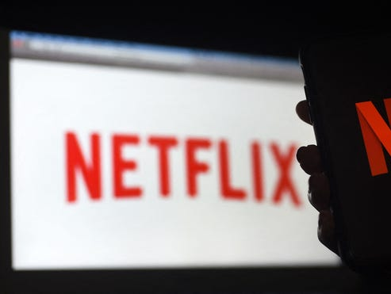
Glossary
TF-IDF: Textual similarity measure.
Word Embeddings: Contextual vector representations.
KNN: Clustering-based recommendation algorithm.
Metadata: Descriptive categorical features like genres or tags.

Slide 28

Acknowledgements
Thanks to the Netflix dataset contributors and the developers of tools like Python, SpaCy, and Scikit-learn.
Special gratitude to my mentor Dr. Ravindranath Arunasalam and peers for guidance and feedback throughout the project.

Slide 29

Thank you!!

